Slide 1

Dental Problem Detection & Classification
– using deep learning and image processing
Miranta Johny
Roll No : 19

Slide 2
01
Relevance of the project
02
A Description of the Project
03
Objectives of Study
04
Existing System and Proposed System
Contents
CONTENTS
05
Input/ Output and Modules.
06
Methodology
07
About User interface design and Back-end design

Slide 3
01
Relevance of topic
Contents

Slide 4
Relevance of the project
Analysis of panoramic dental radiographies help specialists observe problems in poor visibility areas, inside the buccal cavity or in hard to reach areas.
Dental informatics is an emergent field which helps to improve the treatment and diagnosis process, saves time and reduces stress during the daily routine.
The early detection of initial dental caries can prevent invasive treatment, thereby saving healthcare costs.

Slide 5
02
A Description of the Project
Contents

Slide 6
Description
This project include a novel approach for Dental Problem Detection and Classification using Panoramic Dental Radiographies.
A CNN was trained for semantic segmentation information.
Next, multiple image processing operations were performed for segmenting and refining.
Finally, each tooth instance was labeled and the problem affecting it was identified.

Slide 7
Objectives Of Study
To automatically detect teeth problems and to distinguish the problem into different categories.
To aid the medical staff in making decisions regarding the correct diagnosis

Slide 8
03
Existing System and Proposed System
Contents

Slide 9
Existing System
The interpretation of the radiography is done manually by the dentist, who identifies each tooth and the problem is being identified.
However, if the X-ray radiography is not clear it can cause problems when analyzed and thus lead to misinterpretation.

Slide 10
Proposed System
Propose a deep learning solution that helps dentists make the correct diagnosis using panoramic dental X-rays images.
It manually annotate panoramic radiographies in order to train the semantic segmentation CNN.
It segments semantically the panoramic X-Ray image, for 15 semantic classes depicting different dental problems, using a CNN.
The system detect and label each tooth or group of teeth and the dental problem affecting it using multiple image processing techniques.
We evaluate and compare the proposed solution, with other CNNs created for the same task.

Slide 11
04
Input/ Output and Modules
Contents

Slide 12
Input/ Output and Modules
INPUT
The input is the data that contains x-ray image of teeth.
MODULES/TASKS
1. Image Preparation
2. Semantic Segmentation
3. Teeth Detection
4. Results Refinement
5. Dental Problem Classification
OUTPUT
The output predict the specific problem being detected in the X-ray image.

Slide 13
05
Methodology
Contents

Slide 14
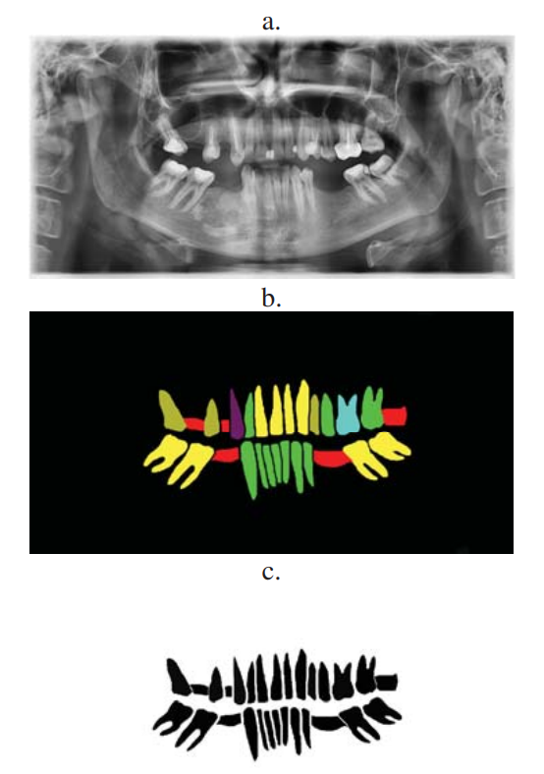
Methodology
The project has the following main parts:
1.Image Preparation and segmentation
All of the images were cropped and resized.
Annotating all these images for semantic segmentation into 14 different classes.Some of the classes are: healthy tooth, missing tooth, implant etc.
Last step is to generate corresponding labels for these classes. i.e have values between 0 and 13.

Slide 15
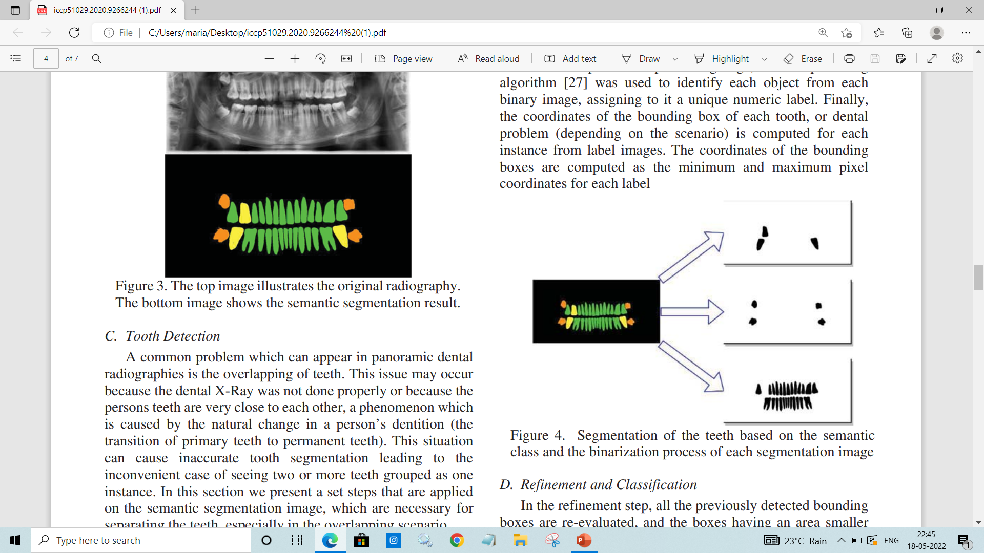
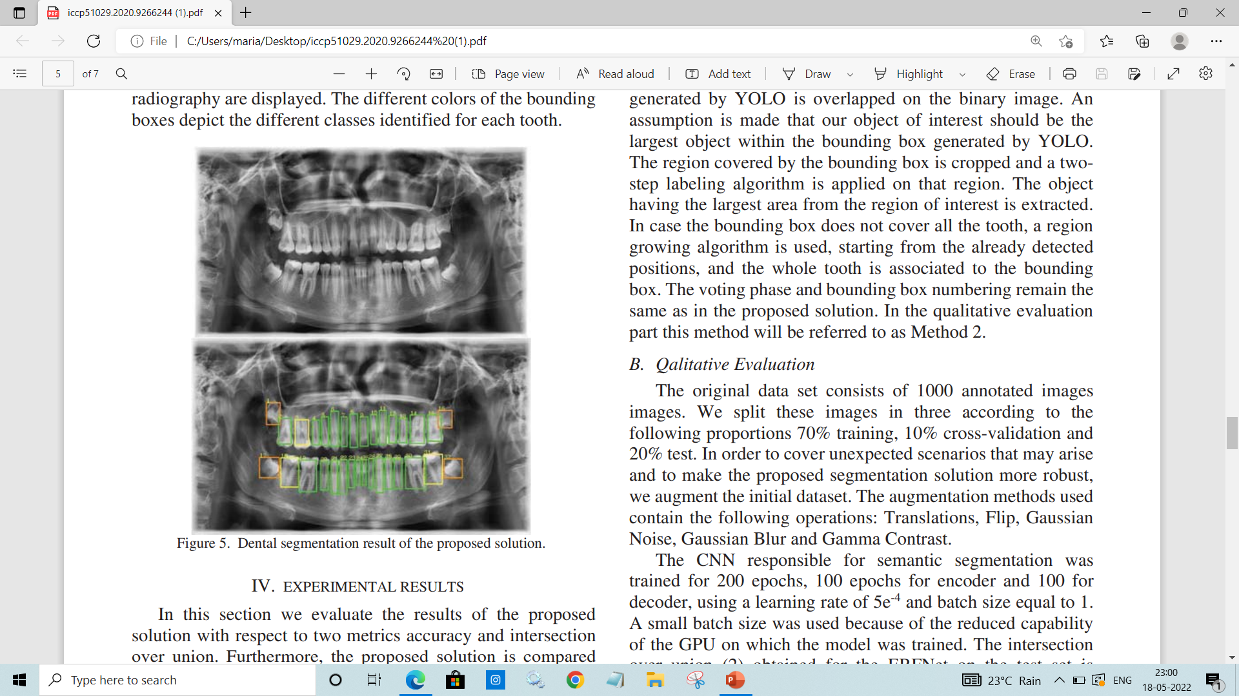
Segmentation of the teeth based on the semantic class and the binarization process of each segmentation image

Slide 16
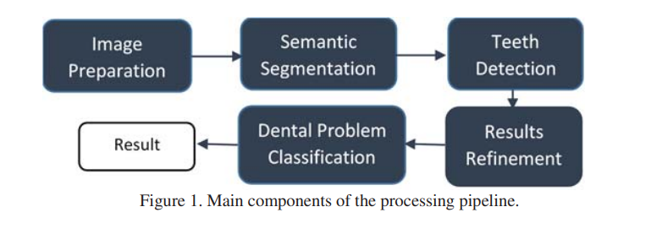
Use Case Diagram

Slide 17
06
About User interface design and Back-end design
Contents

Slide 18
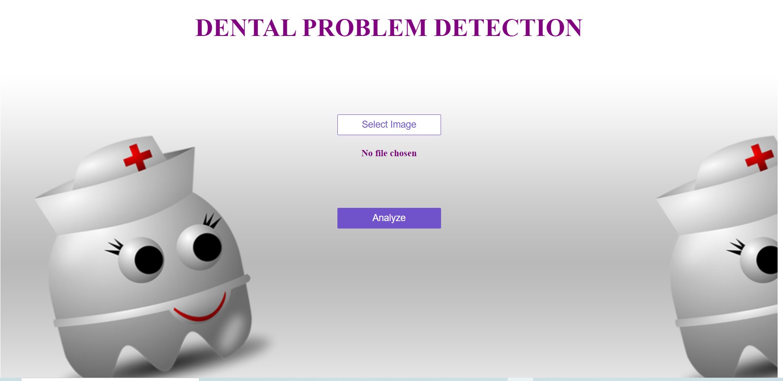
Screenshots

Slide 19
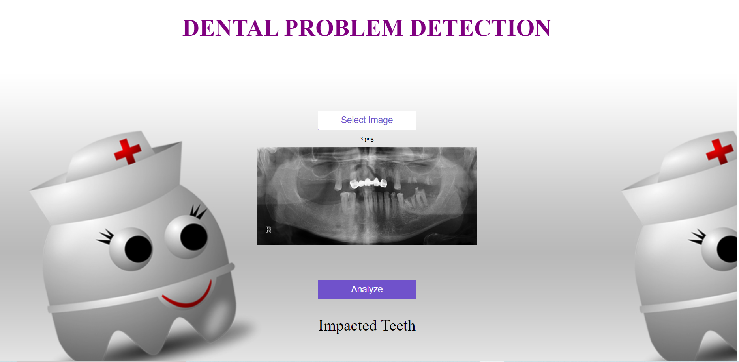

Slide 20
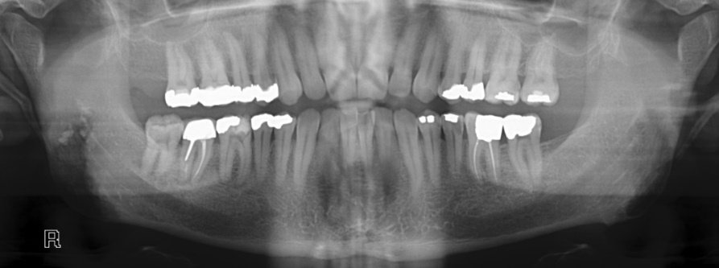
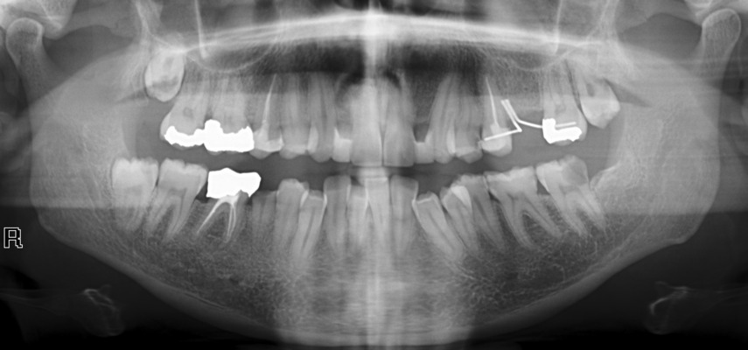
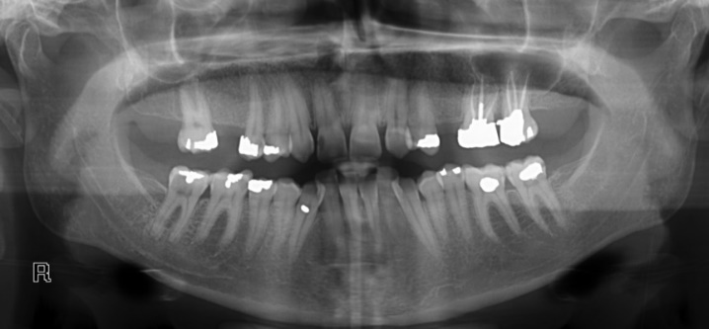
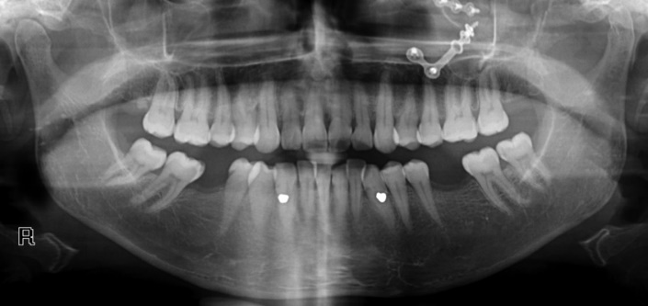
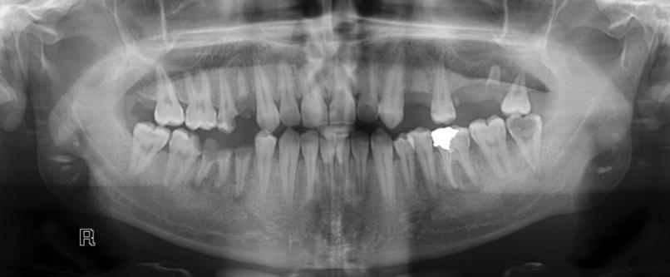
Datasets

Slide 21
Back-end design
PYTHON
OpenCV
HTML/CSS
PYTHON
Reasons for using the Python language in this project is due to its simple syntax, the development of applications with Python is fast when compared to many programming languages.
OpenCV
OpenCV is a cross-platform library using which we can develop real-time computer vision applications. It mainly focuses on image processing, video capture and analysis including features like face detection and object detection.
HTML AND CSS
HTML is Hypertext Markup Language. CSS is Cascading Style Sheet language. HTML is used to structure the content on the web page. CSS is used to add style to the content of a web page.

Slide 22
THANK YOU

